Slide 1
Javascript Basics
… an introduction

Slide 2
Pre-requisites
Any form of basic programming knowledge
Some basic HTML, CSS Knowledge
Basic understanding of procedural programming and object-oriented programming
What do you need to get started with Javascript

Slide 3
What is Javascript used for?

Slide 4
















Basically Everything

Slide 5
Introduction
Compiled vs Interpreted Programming Language*
Has a two phase compilation and execution phase
Doesn't need a build step, unlike traditional compilers like gcc
Runs and executes code until an error occurs
Multi-paradigm language
Allows procedural, object-oriented, functional and more paradigms of programming
Loosely / Dynamically Typed
Does not need explicit type definition
Uses type inference and implicit type setting
A type assigned to a variable can be overridden by another

Slide 6
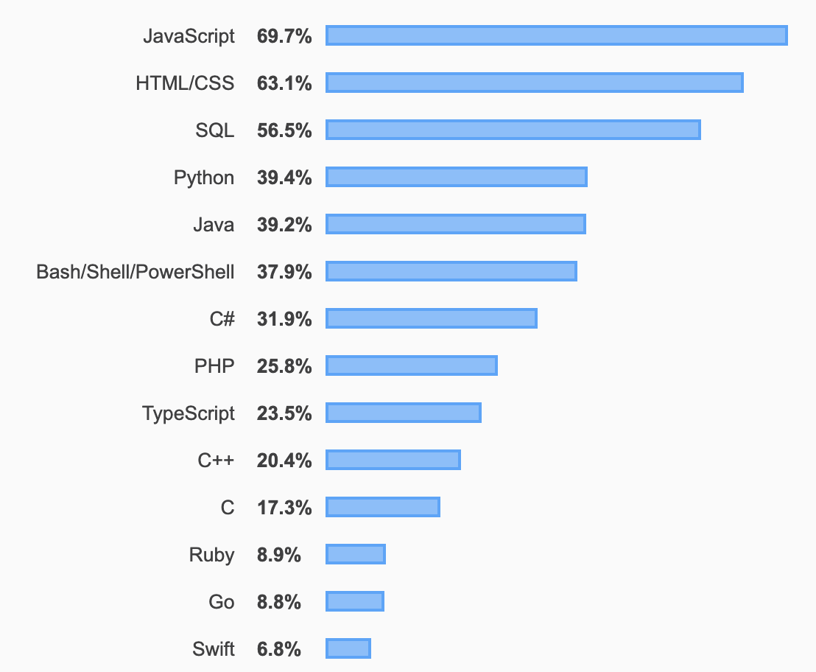
But why though?
The de facto scripting language for Web based applications
Easy to learn and get started with
Build applications for a large range of platforms
Becoming the most popular programming language
Developer survey 2021
Stackoverflow Developer Survey 2019

Slide 7
Getting Started

Slide 8
How to write and run Javascript
Internal Script
<script>/* Write some JS code */</script>
External Script
<script src="./scripts/home.js"></script>
Browser Console
Open the console tab in browser developer tools and write commands there.
Ctrl + Shift + J OR Cmd + Alt + J

Slide 9
The easy stuff...

Slide 10
Variables
var myNum = 10; var myStr = 'Hello World'; var myBool = true; console.log(myNum, typeof myNum); console.log(myStr, typeof myStr); console.log(myBool, typeof myBool); myNum = '10'; console.log(myNum, typeof myNum);

Slide 11
Data Types in JavaScript
Primitive Data Types
Number
Boolean
String
Null
Undefined
Non Primitive Data Types
Object
Array

Slide 12
String Operations
var myStr = 'Hello World'; console.log(myStr.length); console.log(myStr.indexOf('ell'), myStr.indexOf('www')); console.log(myStr[0], myStr[myStr.length - 1]); console.log(myStr.concat('hello'), myStr); console.log(myStr.split('ll')); console.log(myStr.toUpperCase()); console.log(myStr.substr(1, 5));

Slide 13
Null and Undefined
var a; console.log(a); var b = null; console.log(b);
null, undefined, '', 0 and false are `false` values.
Everything else is true.

Slide 14
Object
var obj = { num: 10, key: 'value', isTrue: true, arr: [1, 2, 3, 4, 5] }; console.log(obj.num, obj['key'], obj.val); obj.isTrue = 1; obj.val = { newKey: 'newVal' }; console.log(obj.val.newKey);

Slide 15
Array
var array = [1, 2, 3, 'four', true, [1, 2, 3]]; array.push(10); array.pop();
[1, 2, 3].push(20); console.log(array[2]); console.log(array.length); console.log(array.indexOf(0)); console.log(array.slice(1, 2), array); console.log(array.splice(2, 3), array);
[].concat([1, 2, 3], ['a', 'b'], 5);

Slide 16
Comparison and operators
true && true true || true !true !!true !!0 !!1 !!-1 !![] !!{} !!'' !!'Hello' !!null !!undefined
1 == 1; 1 == 2; 1 == '1'; 1 === '1'; 1 <= 2; 1 >= 0; 'a' < 'b'; 'c' > 'b' 'Hello' < 'Hello World'

Slide 17
Conditionals
if (condition) { // do something } if (condition1) { // do something } else if (condition2) { // do something } else { // do something }
switch (variable) { case value1: // do something break; case value2: { // do something break; } default: // do something }
var value = condition ? value1 : value2;

Slide 18
Loops
var a = [1, 2, 3, 4]; for (var i = 0; i < a.length; i++) { console.log(i, a[i]); } for (var i = 0; i < a.length; i++) { console.log(i, a[i]); if (a[i] === 3) { break; } }
var a = [1, 2, 3, 4]; var i = 0; while (i < a.length) { console.log(i, a[i]); i++; } var j = 0; do { console.log(j, a[j]); j++; } while (j < a.length);

Slide 19
Iterating over objects
var obj = { id: 1, name: 'John Doe' }; var keys = Object.keys(obj); for (var i = 0; i < keys.length; i++) { var key = keys[i]; var value = obj[key]; console.log(key, value); }
Try the same with Object.values(obj)

Slide 20
Functions
function getSum(a, b) { return a + b; } getSum(1, 3); var getSum = function(a, b) { return a + b; } getSum(1, 3);
function getSum(a, b) { function add() { return a + b; } return add(); } getSum(1, 3);

Slide 21
The medium stuff...

Slide 22
Scopes
var globalScope = 10; if (true) { var insideIf = 20; } console.log(insideIf); for (var i = 0; i < 10; i++) { var insideFor = 30; } console.log(insideFor);
function myFunc() { var insideFunction = 40; } myFunc(); console.log(insideFunction);

Slide 23
Hoisting
console.log(myVar); var myVar = 10; console.log(myVar); console.log(myFunc); function myFunc() { return 'Hello'; }
console.log(myFunc2); var myFunc2 = function() { return 'Hello Again'; } console.log(myFunc2);

Slide 24
Function as a response
function init() { // do stuff; return function(a, b) { return a + b; } } var getSum = init(); var sum = getSum(1, 2); var anotherSum = init()(1, 2);

Slide 25
Function as a parameter - Callback
function init(callbackFn) { // do stuff; callbackFn(); } function getValue() { // do more stuff } var getSum = init(getValue); init(function() { // do even more stuff });
// Pseudo Code. Don't try this at home.
function getAPIValue(success, err) { var value = callAPI(); if (value.status === 'success') { success(value); } else { err(value); } } getAPIValue(function(data) { console.log('SUCCESS', data); }, function(err) { console.log('ERROR', err); });

Slide 26
Iterating over Arrays - forEach and map
var array = [1, 2, 3, 4, 5]; var result = array.forEach(function(val, index) { console.log(index, val); return val + 1; }); console.log('ForEach', result, array); var result = array.map(function(val, index) { console.log(index, val); return val + 1; }); console.log('Map', result, array);

Slide 27
Iterating over Arrays - filter
var array = [1, 2, 3, 4, 5]; var result = array.filter(function(val, index) { return val % 2 === 0; // return true or false }); console.log(result);

Slide 28
Transforming Arrays - reduce
var result = array.reduce(function(acc, val, index, src) { return newAccValue; }, defaultValue);
acc = accumulator, val = currentValue, index = currentIndex, src = initialSource var array = [1, 2, 3, 4, 5]; var sum = array.reduce(function(acc, val) { return acc + val; }, 0);

Slide 29
The hard stuff...

Slide 30
Asynchronous actions
var counter = 0; var interval = setInterval(function() { console.log(counter); counter++; }, 1000);
console.log(counter); // clearInterval(interval);
var counter = 0; var timeout = setTimeout(function() { console.log(counter); counter++; }, 1000);
console.log(counter); // clearTimeout(timeout);

Slide 31
Consider this code
for (var i = 0; i < 10; i++) { setTimeout(function() { console.log(i); }, 1000); }
What is the output?

Slide 32
Now this
for (var i = 0; i < 10; i++) { setTimeout((function(val) { return function() { console.log(val); } })(i), 1000); }
What is the output now?
Keywords: IIFE, Closures
IIFE
(function (param) { // do something })(value);

Slide 33
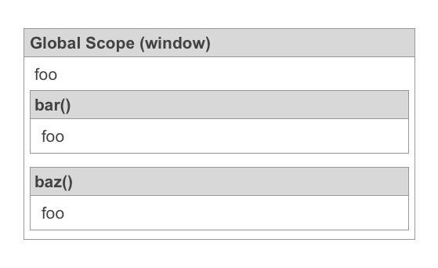
Compilation and Advanced Scopes
1 var foo = 'Global';
2
3 function bar() {
4 var foo = 'Inside bar';
5 }
6
7 function baz(foo) {
8 foo = 'Inside baz';
9 bam = 'Hello World';
10 }

Slide 34
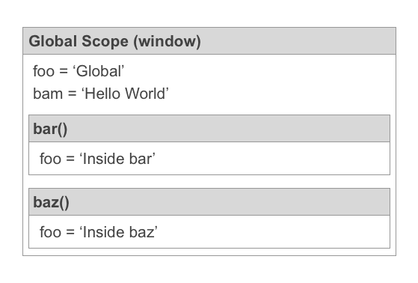
Execution and Advanced Scopes
1 var foo = 'Global';
2
3 function bar() {
4 var foo = 'Inside bar';
5 }
6
7 function baz(foo) {
8 foo = 'Inside baz';
9 bam = 'Hello World';
10 }

Slide 35
Closures
var xyz = 0;
function A (xyz) {
function C () { console.log(xyz); }
function B () {
console.log(xyz);
} return { C: C, B: B }
}
var result = A(xyz);
console.log(result) console.log(result.C())
console.log(result.B())

Slide 36
Advanced Concepts
Types and Coercion https://www.freecodecamp.org/news/js-type-coercion-explained-27ba3d9a2839/
Lexical Scoping and Closures https://medium.com/@nickbalestra/javascripts-lexical-scope-hoisting-and-closures-without-mystery-c2324681d4be
Prototypes and Prototype Chain https://developer.mozilla.org/en-US/docs/Web/JavaScript/Inheritance_and_the_prototype_chain
Event Loop https://flaviocopes.com/javascript-event-loop/ https://medium.com/front-end-weekly/javascript-event-loop-explained-4cd26af121d4 https://www.youtube.com/watch?v=8aGhZQkoFbQ https://www.youtube.com/watch?v=cCOL7MC4Pl0
Concepts that are part of the core javascript functionality

Slide 37
Learning links
https://developer.mozilla.org/en-US/docs/Web/JavaScript/Guide
https://github.com/getify/You-Dont-Know-JS
https://www.tutorialspoint.com/javascript
https://www.javascript.com/try
https://javascript.info/
https://www.learn-js.org/

Slide 38
And that's it.

